Slide 1
CENG 477
Introduction to Computer Graphics
Ray Tracing (2)

Slide 2
Last Week
Until now we learned:
  How to create the primary rays from the given camera and image plane parameters
  How to intersect these rays with various objects:
    Planes
    Spheres
    Triangles
    Cylinders
    Boxes

Slide 3
Algorithm So Far
foreach pixel s:
compute the viewing ray r (from e to s)
t_{min} = ∞, obj = NULL
foreach object o:
if r intersects o:
if t < t_{min}:
t_{min} = t, obj = o
if obj not NULL:
pixel color = color of obj
else
pixel color = color of background

Slide 4

Image So Far
Two spheres with different colors and a gray background
So much work for such a bad image!
The image looks bad because we did not use a realistic shading algorithm
We simply set all surface points to the same color

Slide 5
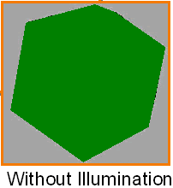
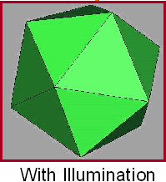
With and Without Illumination
Color itself not enough ☹

Slide 6
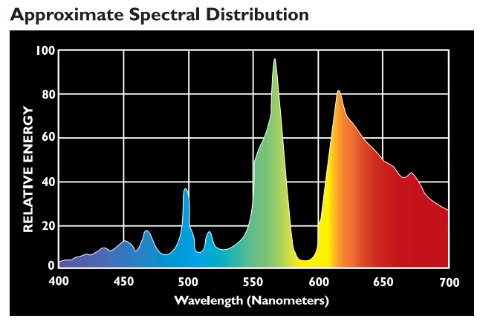

Reflectance and Power
We assumed that each object has a color
This is not how it is in reality
Each object has a reflectance distribution
Each light source has a power distribution
Normally, both are functions of wavelength:
From forums.gardenweb.com

Slide 7
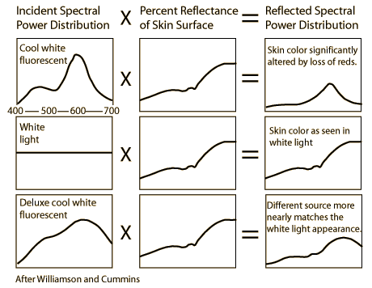
Reflectance and Power
The object color occurs as a result of their interaction
Same object can appear different under different lights

Slide 8
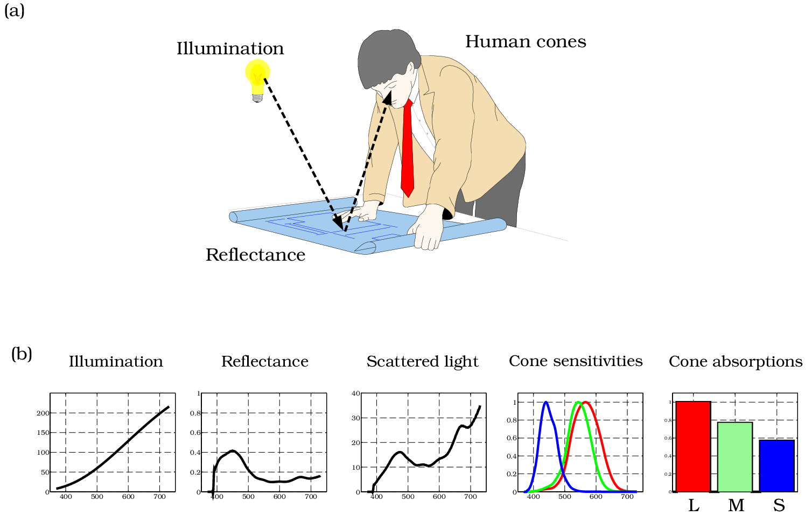
Reflectance, Power, Cones
Color is perceived due to the interaction of this reflected light by our cone pigments
foundationsofvision.stanford.edu

Slide 9
Spectral Ray Tracing
Accurately modeling this process requires us to represent all objects and light sources using spectral (i.e. wavelength-based) distributions
  Built on physically based equations that model the transportation of light. This allows spectral tracers to accurately capture a wide range of phenomena which most other rendering programs are simply unable to reproduce
Some ray-tracers do this:
  Indigo renderer (http://www.indigorenderer.com/)
  Lux renderer (http://www.luxrender.net/)
  Mental ray (http://www.nvidia-arc.com/products/nvidia-mental-ray.html)
  …

Slide 10
RGB Model
We will make a simplifying assumption and represent all objects and light source with three components
Reflectance (obj):
  R_{r}: How much red light it reflects, a value between [0,1]
  R_{g}: How much green light it reflects, a value between [0,1]
  R_{b}: How much blue light it reflects, a value between [0,1]
Power (light):
  I_{r}: How much red light it emits, a value between [0,∞)
  I_{g}: How much green light it emits, a value between [0,∞)
  I_{b}: How much blue light it emits, a value between [0,∞)

Slide 11
Light-Surface Interaction
Light sources are points
Light has a color (mostly white)
Light is pointed to object A
  Bounces off A, bounces of walls, ..
  Illuminating the room
  All these background light assumed to be constant: Ambient Light

Slide 12

Ambient Shading
Without ambient lights parts of the sphere that do not face the light source are all black
  Not realistic
Ambient shading is used as a very crude approximate of the integral in rendering equation; just a constant:
$$L_{o}^{a}(x,wo) =kaIa$$
Ambient
light intensity
Outgoing
radiance
Ambient
reflectance
coefficient

Slide 13
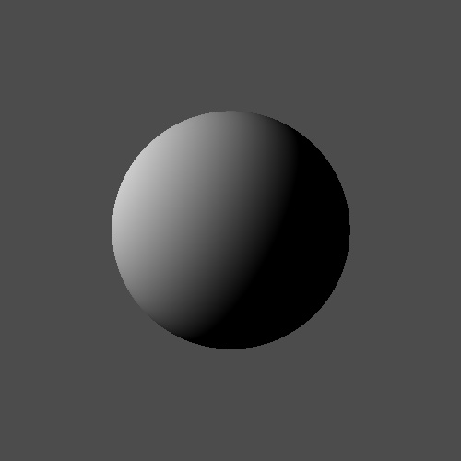
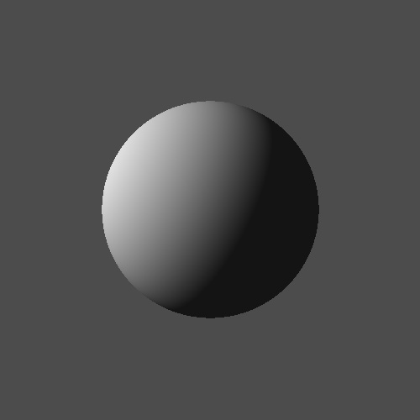
Ambient Shading
Diffuse only
Diffuse + Ambient

Slide 14
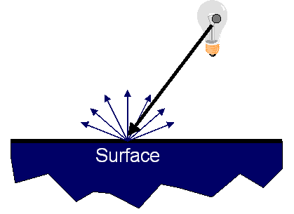
Light-Surface Interaction
When you put light into a surface, surface scatters the light
  Due to the little tiny micro facets on the surface
Scattering controlled by Lambert’s law
  If light is barely grazing the surface, very little scattering
  If light is looking straight at the surface, lots of scattering
Lambert’s law (cosine law) assumes a perfectly diffusing surface
  Surface reflects equally in all directions (looks equally bright from all viewing directions)

Slide 15
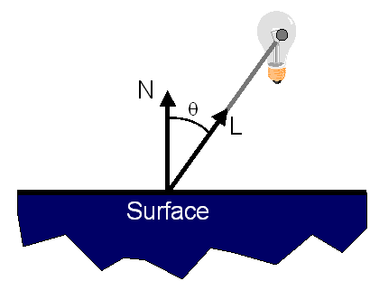
Light-Surface Interaction
When you put light into a surface, surface scatters the light
  Due to the little tiny micro facets on the surface
Scattering controlled by Lambert’s law
  If light is barely grazing the surface, very little scattering
  If light is looking straight at the surface, lots of scattering
Lambert’s law (cosine law) assumes a perfectly diffusing surface
  Surface reflects equally in all directions
  Amount of reflection depends on the positioning of light and normal

Slide 16

Diffuse Shading
Simulates the phenomenon that a surface can receive radiation only in proportion to its area projected in the direction of the light:
$$L_{o}^{d}(x,wo)=kdcosθ′Li\left(x, wi\right)$$
w_{i}
n
w_{o}
Θ’
Diffuse
reflectance
coefficient
Outgoing
radiance
Incoming
radiance
x
$$cosθ′=max⁡(0, wi.n)$$

Slide 17
Diffuse Shading
Note that a diffuse surface reflects equal radiance in all directions (looks equally bright from all viewing directions)
Such a surface is called a Lambertian surface (1760)
$$L_{o}^{d}(x,wo)=kdcosθ′Li\left(x, wi\right)$$
w_{i}
n
w_{o}
Θ’
Diffuse
reflectance
coefficient
Outgoing
radiance
Incoming
radiance
x
$$cosθ′=max⁡(0, wi.n)$$

Slide 18
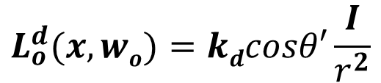

Diffuse Shading
Also, for a point light source, we may apply the inverse square law to attenuate the light based on its distance
This is optional but improves realism
Light intensity
I
$$L_{o}^{d}(x,wo)=kdcosθ′\frac{I}{r^{2}}$$
w_{i}
r
n
w_{o}
Θ’
Outgoing
radiance
Diffuse
reflectance
coefficient
x
Light distance
$$cosθ′=max⁡(0, wi.n)$$

Slide 19
Diffuse Shading Example
A sphere shaded by diffuse shading:
directxtutorial.com

Slide 20
Illumination So Far
Let Cr, Cg, Cb be the base color of the object n
  E.g., (1,0,0) if the object is red l (light)
Illumination/Intensity at point x
  Ir = Cr*(AMBr + DIFr * n.l)
  Ig = Cg*(AMBg + DIFg * n.l)
  Ib = Cb*(AMBb + DIFb * n.l)
  Ambient constant (AMBr/g/b) typically 0.2
  Diffuse constant typically 0.5
  Note that n.l is the cos of the angle between n & l as they are unit
  Summary: decide how much base color is reflected
Θ’

Slide 21
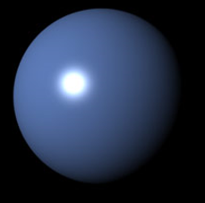
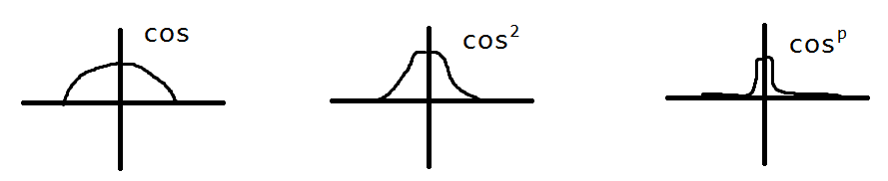
Add Specular Light
r
1 more thing: Speculation/highlights e (eye) n
a l (light)
How light l reflects of something?
  Primarily of direction r
  If angle a is 0 then eye should get all the lights reflected back to it
  If you are off the reflection vector, you get lesser reflection
  e.r gives the desired angle (cos of it)
    Cosine falls off to slowly; we want highlights; not diffuse a lot; fade out quickly!!
    How about this for quick fall off? (e.r)^{p} (p is called glossiness)
    dies of quickly

Slide 22
Add Specular Light
h
1 more thing: Speculation/highlights e (eye) n
b l (light)
How light l reflects of something?
  Calculating r is hard ☹
  Exponentiation is expensive ☹
  Something more practical
    h: Halfway between l and e
    Consider angle b between n and h
    If b=0, then e will be at the perfectly reflecting direction
      Insight: If the normal was h it would be reflecting perfectly
      b measures how far h is off the real normal
    Hence, use specular light term as SPE * (n.h)^{p}
      SPE constant: only a portion of light is reflected

Slide 23
Putting It All Together
h
Let Cr, Cg, Cb be the base color of the object n
  E.g., (1,0,0) if the object is red l (light)
Illumination at point x
  Ir = Cr*(AMBr + DIFr * n.l) + CLr * SPEr * (n.h)^{p}
  Ig = Cg*(AMBg + DIFg * n.l) + CLg * SPEg * (n.h)^{p}
  Ib = Cb*(AMBb + DIFb * n.l) + CLb * SPEb * (n.h)^{p}
  CL is the color of the light source (to be blended w/ base color)
    Typically white: (1, 1, 1)
  Specular constant typically 0.3
  Summary: decide how object reflects light specularly (highlights)

Slide 24
Putting It All Together
h
Let Cr, Cg, Cb be the base color of the object n
  E.g., (1,0,0) if the object is red l (light)
Illumination at point x
  Ir = Cr*(AMBr + DIFr * n.l) + CLr * SPEr * (n.h)^{p}
  Ig = Cg*(AMBg + DIFg * n.l) + CLg * SPEg * (n.h)^{p}
  Ib = Cb*(AMBb + DIFb * n.l) + CLb * SPEb * (n.h)^{p}
  For each object how many new parameters you need to specify?

Slide 25
Putting It All Together
h
Let Cr, Cg, Cb be the base color of the object n
  E.g., (1,0,0) if the object is red l (light)
Illumination at point x
  Ir = Cr*(AMBr + DIFr * n.l) + CLr * SPEr * (n.h)^{p}
  Ig = Cg*(AMBg + DIFg * n.l) + CLg * SPEg * (n.h)^{p}
  Ib = Cb*(AMBb + DIFb * n.l) + CLb * SPEb * (n.h)^{p}
  For each object how many new parameters you need to specify?
    Cr, Cg, Cb, DIFr, DIFg, DIFb, SPECr, SPEg, SPEb, p //ambient & lightColor fixed

Slide 26
Putting It All Together
h
Let Cr, Cg, Cb be the base color of the object n
  E.g., (1,0,0) if the object is red l (light)
Illumination at point x
  Ir = Cr*(AMBr + DIFr * n.l) + CLr * SPEr * (n.h)^{p}
  Ig = Cg*(AMBg + DIFg * n.l) + CLg * SPEg * (n.h)^{p}
  Ib = Cb*(AMBb + DIFb * n.l) + CLb * SPEb * (n.h)^{p}
  Our color model to color our objects includes
    Base color Cr/g/b
    How much that base color is reflected
    How object reflects light specularly (highlights)

Slide 27
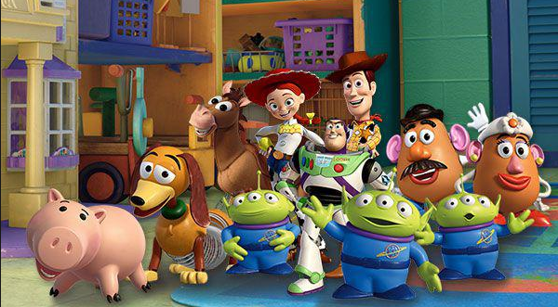
Putting It All Together
h
Let Cr, Cg, Cb be the base color of the object n
  E.g., (1,0,0) if the object is red l (light)
Illumination at point x
  Ir = Cr*(AMBr + DIFr * n.l) + CLr * SPEr * (n.h)^{p}
  Ig = Cg*(AMBg + DIFg * n.l) + CLg * SPEg * (n.h)^{p}
  Ib = Cb*(AMBb + DIFb * n.l) + CLb * SPEb * (n.h)^{p}
  Our color model to color our objects includes
    Pretty good as long as surfaces look like plastics
      Toy Story objects

Slide 28
Putting It All Together
h
Let Cr, Cg, Cb be the base color of the object n
  E.g., (1,0,0) if the object is red l (light)
Illumination at point x
  Ir = Cr*(AMBr + DIFr * n.l) + CLr * SPEr * (n.h)^{p}
  Ig = Cg*(AMBg + DIFg * n.l) + CLg * SPEg * (n.h)^{p}
  Ib = Cb*(AMBb + DIFb * n.l) + CLb * SPEb * (n.h)^{p}
  Play with this model for cool effects
    Orange ball → orange //bump mapping; play with
      In orange normal vectors vary as opposed to the smooth ball surface
    Texturing //play with the color you map on the surface Cr/g/b
    Vary reflections on objects //play with l
    Write your gf’s name with glossy characters //play with p

Slide 29

Color Model Output
Diffuse + Ambient
Diffuse + Ambient + Specular

Slide 30
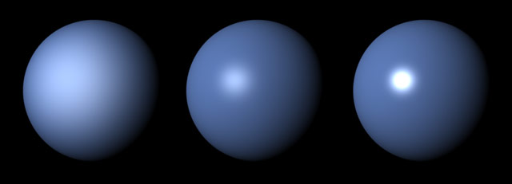
Color Model Output
Larger glossiness exponent (p) makes the highlight more focused
http://cgru.sourceforge.net/

Slide 31
Terms
The following terms are important when talking about light-surface interaction:
  Power, aka Radiant Power
  Intensity, aka Radiant Intensity
  Radiance
  Irradiance
We already used them but let’s formalize definitions

Slide 32
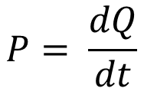
Power
Power is the time-rate of energy
It measures how much energy (i.e. in Joules) a light source emits in all possible directions per second
Power is measured in Watts (W = J/s)
Power (P) is also known as flux (Φ)
Rate at which light energy is transmitted
Energy
$$P= \frac{dQ}{dt}$$
time

Slide 33
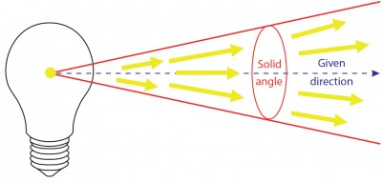
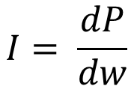
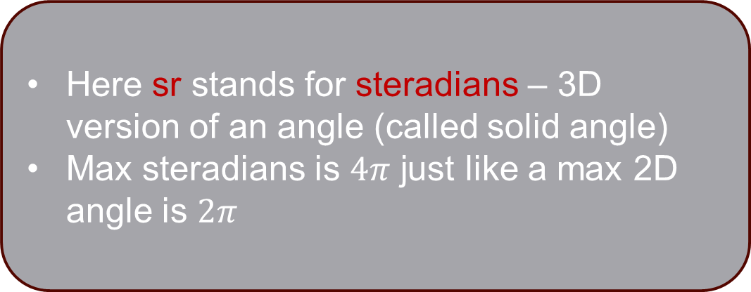
Intensity
Intensity is defined as power per solid angle
Typically defined for point light sources and measured in W/sr
Energy distribution of a light source (inverse square law)
Here sr stands for steradians – 3D version of an angle (called solid angle)
Max steradians is $4π$ just like a max 2D angle is $2π$
Power
$$I= \frac{dP}{dw}$$
lec-expert.com
Solid angle

Slide 34
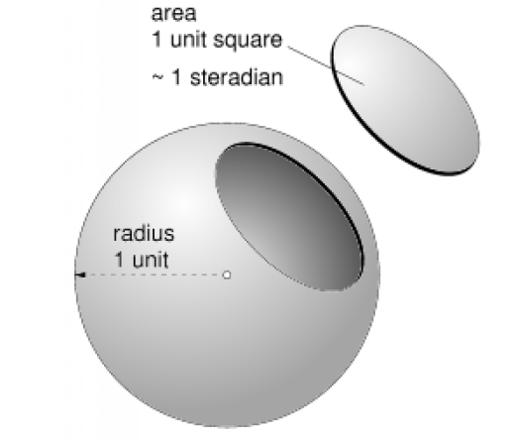
Solid Angle
Solid angle is the 3D generalization of the angle
It corresponds to a surface area on a unit sphere
  similar to angle corresponding to a length on a unit circle
  measured in steradians

Slide 35
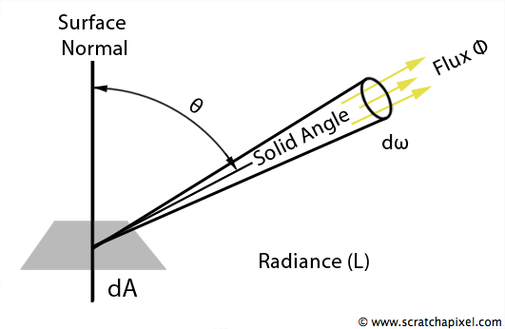
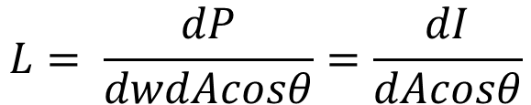
Radiance
Radiance is defined as power per solid angle per projected area
Radiant intensity per projected area
  Light carried by a single ray (no inverse square law)
Measured in Watts per steradian per meter squared (W/sr/m²)
Intensity
$$L= \frac{dP}{dwdAcosθ}=\frac{dI}{dAcosθ}$$
Projected area

Slide 36
Radiance
Radiance is the most important unit in ray tracing
Radiance of a ray does not change as the ray travels in empty space (no inverse square law)
The Goal of Ray Tracing
Compute the radiance along each viewing ray

Slide 37
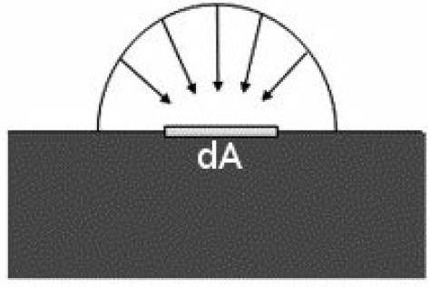
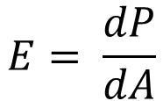
Irradiance
Irradiance measures the total incident power per unit area
Measured in W/m²
Power
$$E= \frac{dP}{dA}$$
Area

Slide 38
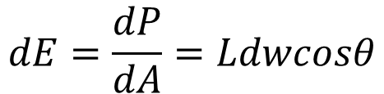
Irradiance from Radiance
Irradiance can be computed from radiance:
L
n
Θ
dw
$$dE=\frac{dP}{dA}=Ldwcosθ$$
dA

Slide 39
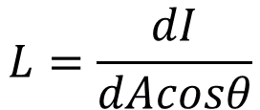

Radiance from Intensity
Finally, radiance can be computed from intensity:
I
L
n
Θ
dw
$$L=\frac{dI}{dAcosθ}$$
dA
$$dAcosθ$$

Slide 40

Radiance from Intensity
Now, imagine that dA was further away
The same intensity would be spread over a larger area
This relationship is governed by the inverse square law
I
dw
$$L=\frac{dI}{dAcosθ}$$
n
L
Θ
$$dAcosθ$$
dA

Slide 41
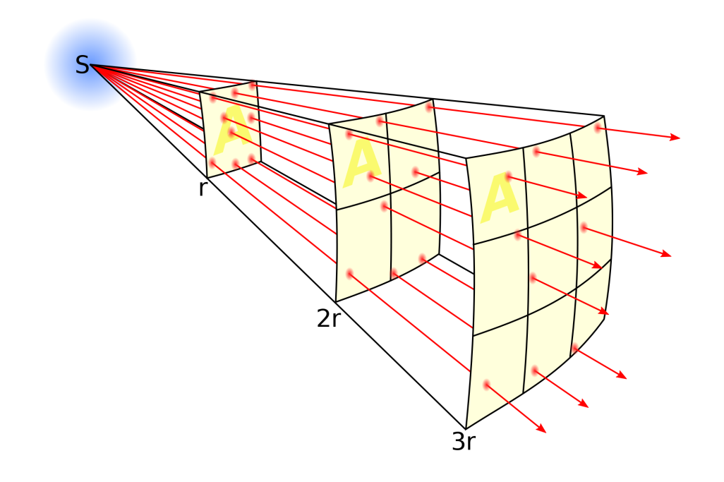
Inverse Square Law
The irradiance emitted by a point light source is reduced by the square of the distance from the source

Slide 42
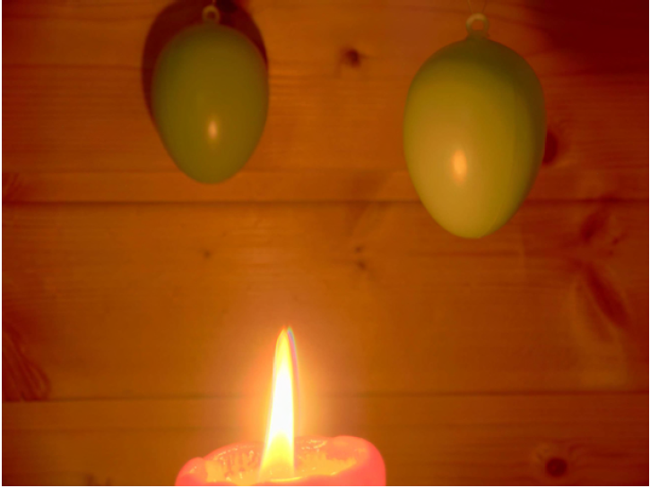
Inverse Square Law
Objects further away from the light source appear dimmer as a result
This is why the distance of the stars can be judged by their brightness

Slide 43
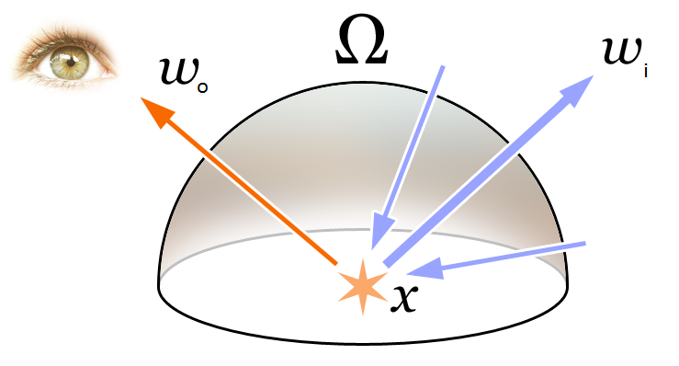
Rendering Equation
Formally these concepts gives us an equation known as the rendering equation
  We already discretized it with our color model
It models how much light arriving from an incoming direction (w_{i}) is reflected toward an outgoing direction (w_{o})

Slide 44
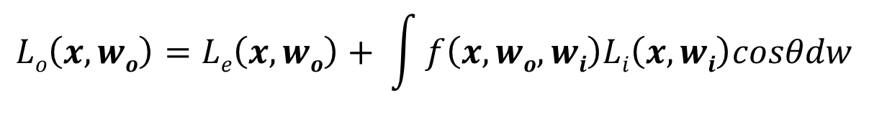
Rendering Equation
Integration over
hemisphere
$$Lo\left(x, wo\right)=Le\left(x, wo\right)+ \int{f\left(x, wo, wi\right)Li\left(x, wi\right)cosθdw}$$
Ω
Area
correction
factor
Outgoing
radiance
Emitted
radiance
Reflectance
Function (BRDF)
Incoming
radiance
Differential
solid angle

Slide 45
Rendering Equation
Too costly to evaluate
For each surface point x we need to integrate over the entire hemisphere surrounding x
Simplification:
  Exclude all directions except light sources
  Add an ambient term to simulate what was excluded
  Done with our color model (Slide 26)

Slide 46
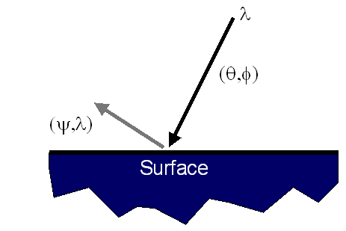
Rendering Equation
Our color model is just an approximation
  Maybe the biggest hack in Computer Science
Ideally measure radiant energy for ALL combinations of incident angles
  Too much storage
  Difficult in practice

Slide 47
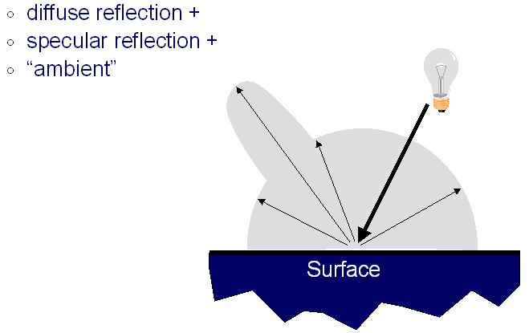
Rendering Equation
Our color model is just an approximation
  Maybe the biggest hack in Computer Science
Instead using a simple analytical model

Slide 48
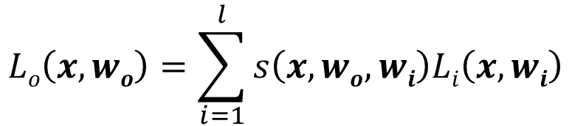
Rendering Equation
We approximated the rendering equation as a sum of three simple shading models through our color model:
  Diffuse shading
  Specular shading
  Ambient shading
All models are based on a modified rendering equation:
Number of lights
$$Lo\left(x, wo\right)=\sum_{i=1}^{l}{s\left(x, wo, wi\right)Li\left(x, wi\right)}$$
Incoming radiance
Outgoing
radiance
Surface reflectance

Slide 49
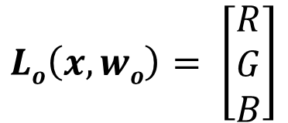
Rendering Equation
We can rewrite our color model in terms of Ls
The color of an object at any point can be computed by combining diffuse, ambient, and specular components:
Note that L is vector-valued in which each component represents the radiance for each color channel
$${{L_{o}^{}\left(x,wo\right)=L}_{o}^{d}\left(x,wo\right)+L}_{o}^{a}\left(x,wo\right)+L_{o}^{s}(x,wo)$$
$$Lo\left(x, wo\right)= \left[\begin{matrix}R \\ G \\ B\end{matrix}\right]$$

Slide 50
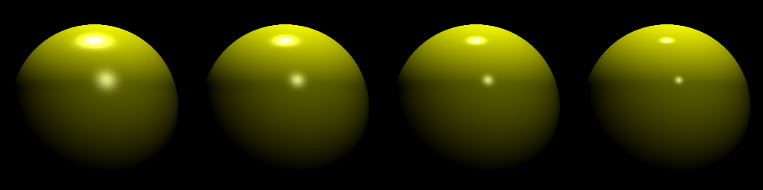
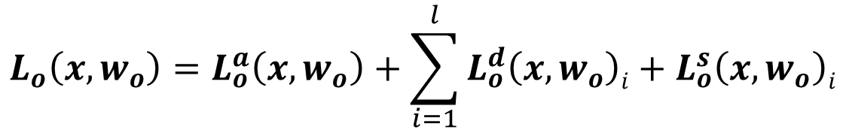
Rendering Equation
Diffuse and specular contribution of each light source must be accumulated:
Number of light sources
$$L_{o}\left(x, w_{o}\right)=L_{o}^{a}\left(x,w_{o}\right)+\sum_{i=1}^{l}{L_{o}^{d}\left(x,w_{o}\right)i+L_{o}^{s}\left(x,w_{o}\right)i}$$
L2program.com

Slide 51
Surface Normals (Reminder)
A surface normal is a unit vector which is orthogonal to the surface and points outward from the surface
n
n₁
x₁
x₂
x
n₂

Slide 52


Surface Normals (Reminder)
Depends on the type of the object:
  For a plane, surface normal is given so you don’t have to do anything (except to normalize it if it isn’t normalized).
  For a sphere, compute:
  For a triangle, compute cross product of two edge vectors:
p
n
$$n= \frac{p −c}{R}$$
c
R
c
n
$$n= \frac{\left(b−a\right)x(c−a)}{\left\|(b−a)x(c−a)\right\|}$$
c - a
b - a
a
b

Slide 53
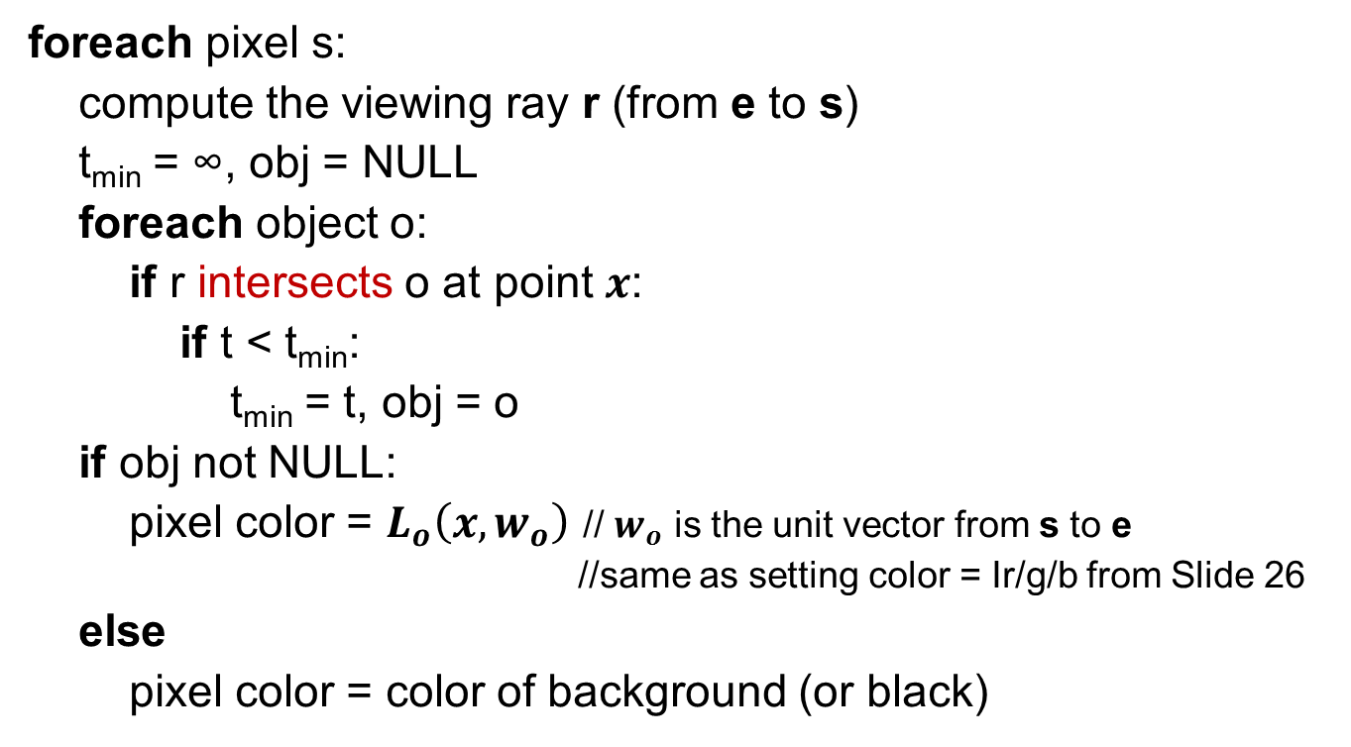
The Ray Tracing Algorithm – So Far
foreach pixel s:
compute the viewing ray r (from e to s)
t_{min} = ∞, obj = NULL
foreach object o:
if r intersects o at point $x$:
if t < t_{min}:
t_{min} = t, obj = o
if obj not NULL:
pixel color = $L_{o}\left(x, w_{o}\right)$ // $w_{o}$ is the unit vector from s to e
//same as setting color = Ir/g/b from Slide 26
else
pixel color = color of background (or black)

Slide 54
Shadows
Shadows can easily be added by checking if the light source is visible from the intersection point
  Send ray from object to light (usually: from camera to object)
In the configuration below, point x is in shadow:
w_{i}
n
h
Θ
α
w_{o}
x

Slide 55

Shadows
To check if the light source is visible from the intersection point, we can create shadow rays, one for each light source
w_{i}
$$s\left(t\right)=x+twi$$
n
h
Θ
α
w_{o}
x

Slide 56
Shadows
Intersect s(t) with all the objects in the scene. If there is no intersection before the light source, the point is not in shadow. Otherwise it is in shadow
$$s\left(t\right)=x+twi$$
w_{i}
n
h
Θ
α
w_{o}
x

Slide 57

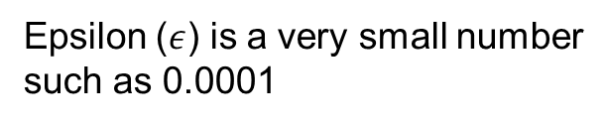
Shadows
To avoid self intersection due to floating point precision problems, the origin is offset by a very small amount:
$$s\left(t\right)=\left(x+wi\right)ε+twi$$
w_{i}
n
h
Θ
α
w_{o}
Epsilon ($ε$) is a very small number
such as 0.0001
x

Slide 58
The Ray Tracing Algorithm – So Far
foreach pixel s:
compute the viewing ray r (from e to s)
t_{min} = ∞, obj = NULL
foreach object o:
if r intersects o at point x:
if t < t_{min}:
t_{min} = t, obj = o
if obj not NULL: // viewing ray intersected with an object
pixel color = L_{a} // ambient shading is not affected by shadows
foreach light l:
compute the shadow ray s from x to l
foreach object p:
if s intersects p before the light source:
continue the light loop; // point is in shadow – no contribution from this light
pixel color += L_{d} + L_{s} // add diffuse and specular components for this light source
else
pixel color = color of background (or black)

Slide 59
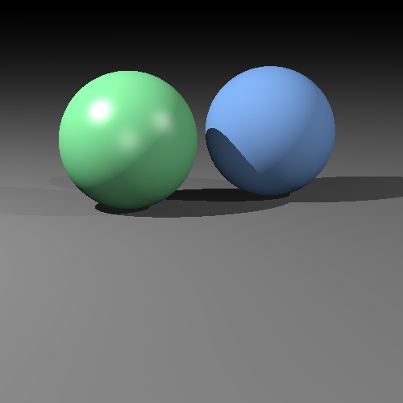
Image So Far
This looks much better! ☺

Slide 60
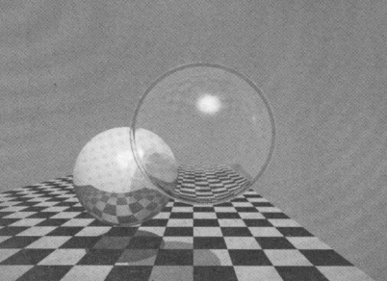
Recursive Ray Tracing
Ray tracing is recursive by nature
Color of obj2 contributes to the color of the current obj1 (if obj1 is reflective -- mirror-like for efficiency)

Slide 61
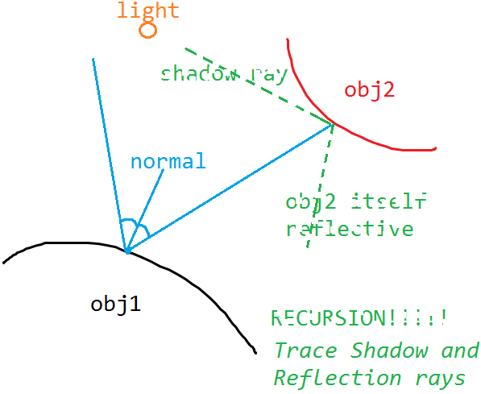
Recursive Ray Tracing
Ray tracing is recursive by nature
Color of obj2 contributes to the color of the current obj1
To determine color at obj2, check its shadow ray, and reflection ray, redo for the obj3, ..

Slide 62
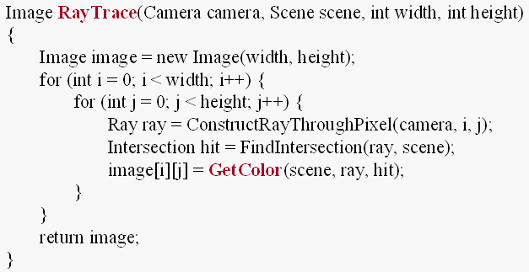
Recursive Ray Tracing
Ray tracing is recursive by nature
GetColor calls RayTrace recursively
  E.g. to be able to reuse the ray generation and intersection code

Slide 63
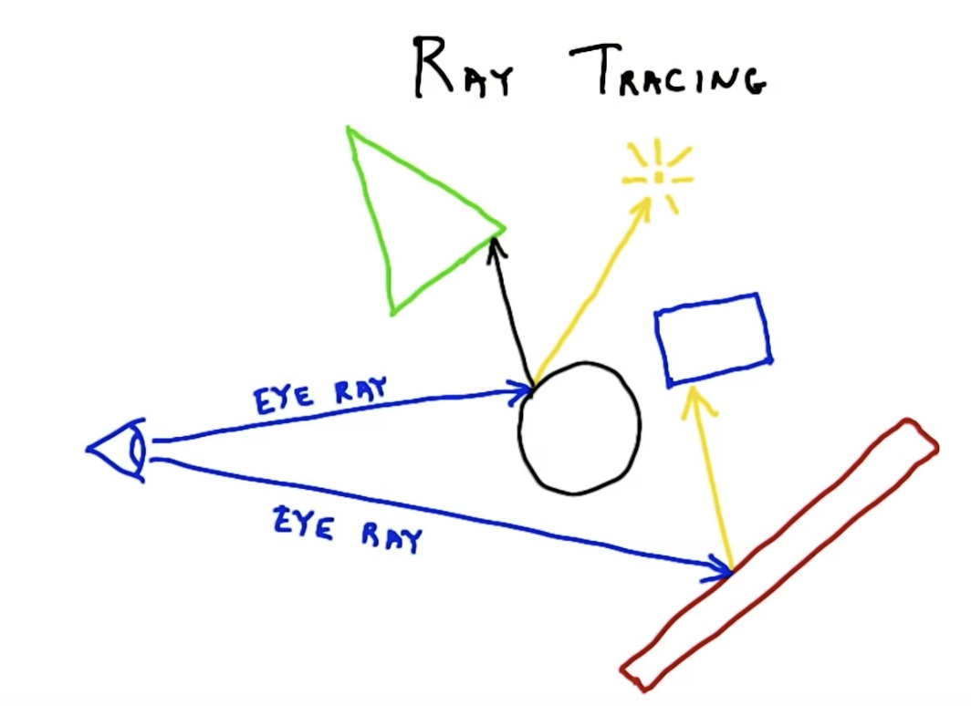
Recursive Ray Tracing
True reflection effect is possible via ray tracing
For shiny/mirror-like surfaces (sphere below), spawn a new ray in the reflection direction
Whatever this ray hits (tetrahedron below) is what is reflected in the surface, so can be factored in the ray’s final color
Recall that yellow is shadow ray

Slide 64
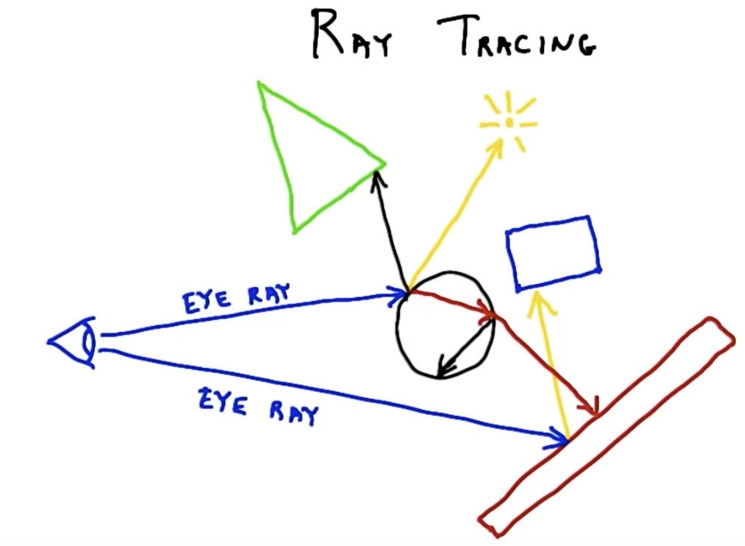
Recursive Ray Tracing
True glass effect is also possible via ray tracing
For glassy surfaces (sphere below), spawn a refraction ray and see where it hits; spawn yet another refraction ray from that exit location
Whatever this ray hits (long box below) is what is reflected in the surface, so can be factored in the ray’s final color
Continue to spawn rays (reflection, refraction) until some limit

Slide 65

True Reflection (Mirrors)
Back to true reflection effect
Mirror-like objects reflect colors of other objects
Given w_{o}, we must compute w_{r} (reflection direction)
w_{r}
w_{r} = -w_{o} + 2ncosΘ = -w_{o} + 2n(n.w_{o})
n
Θ
Θ
w_{o}
n, w_{o}, w_{r} are all unit vectors
x
$$L_{o}^{m}(x,wo)=kmLi\left(x, wr\right)$$
Mirror reflection coefficient

Slide 66
True Reflection (Mirrors)
Derivation of reflection vector r
Given incoming light direction d and surface normal n
Hence, r = (-d.n)n + d+(-d.n)n = d + 2(-d.n)n
d
n
d + (-d.n)n
d + (-d.n)n
(-d.n)n
d + (-d.n)n
r

Slide 67
True Reflection (Mirrors)
For these surfaces the total radiance is equal to local shading radiance plus the radiance from the mirrored location
w_{r}
n
Θ
Need to stop after a fixed
number of bounces to avoid
potentially infinite recursion
Θ
w_{o}
x
$${{L_{o}^{}\left(x,wo\right)=L}_{o}^{d}\left(x,wo\right)+L}_{o}^{a}\left(x,wo\right)+L_{o}^{s}\left(x,wo\right)+L_{o}^{m}(x,wo)$$

Slide 68
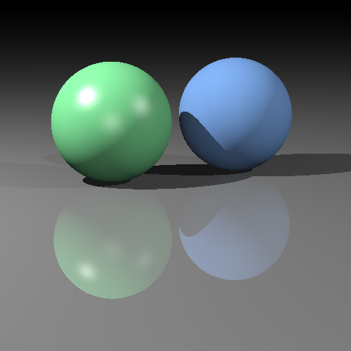
Final Image
This looks much better! ☺

Slide 69
Ray Tracing
We have only scratched the surface of ray tracing.
There is so much more that can be done:
  Acceleration structures
  Modeling non-point light sources (area lights)
  Refraction (glass-like materials)
  Participating media (fog, smoke)
  Subsurface scattering (candles)
  Parallel and interactive ray tracing
  Ray tracing on the GPU
  Photon mapping
  Image-based lighting
  …
Ray tracing also useful for picking: When the user clicks the mouse on a pixel in a 3D graphics program, the program needs to determine which object is visible within that pixel.

Slide 70
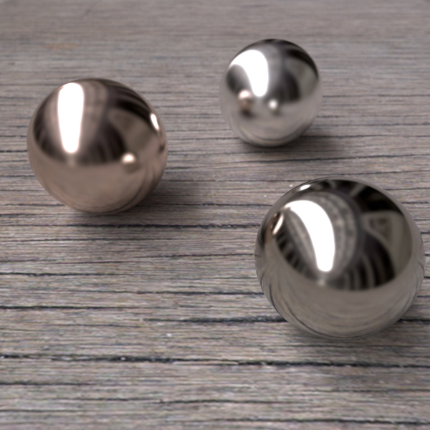
Some Ray-traced Images

Slide 71
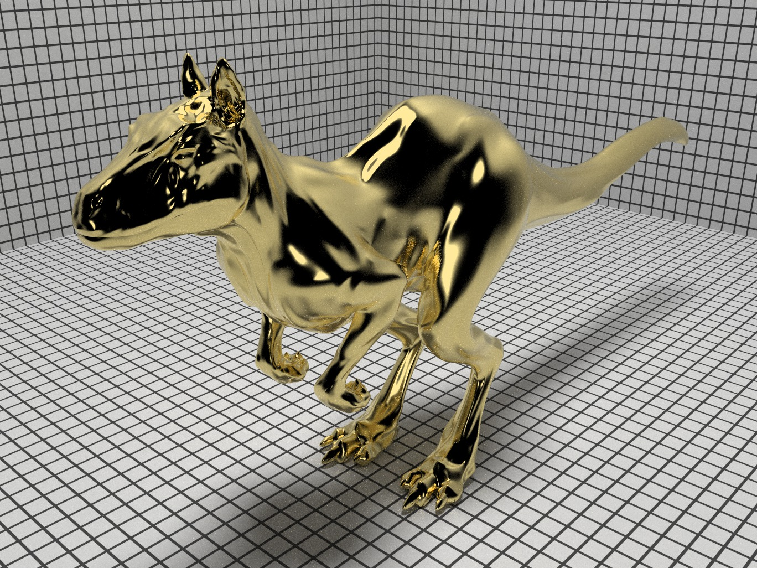
Some Ray-traced Images
Physically Based Ray Tracer

Slide 72
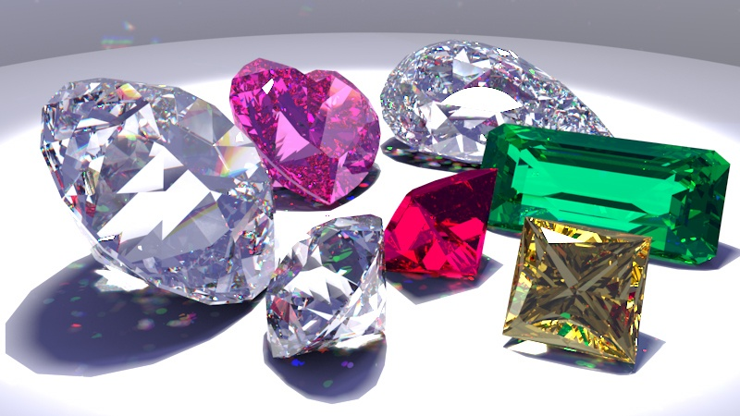
Some Ray-traced Images
Physically Based Ray Tracer

Slide 73
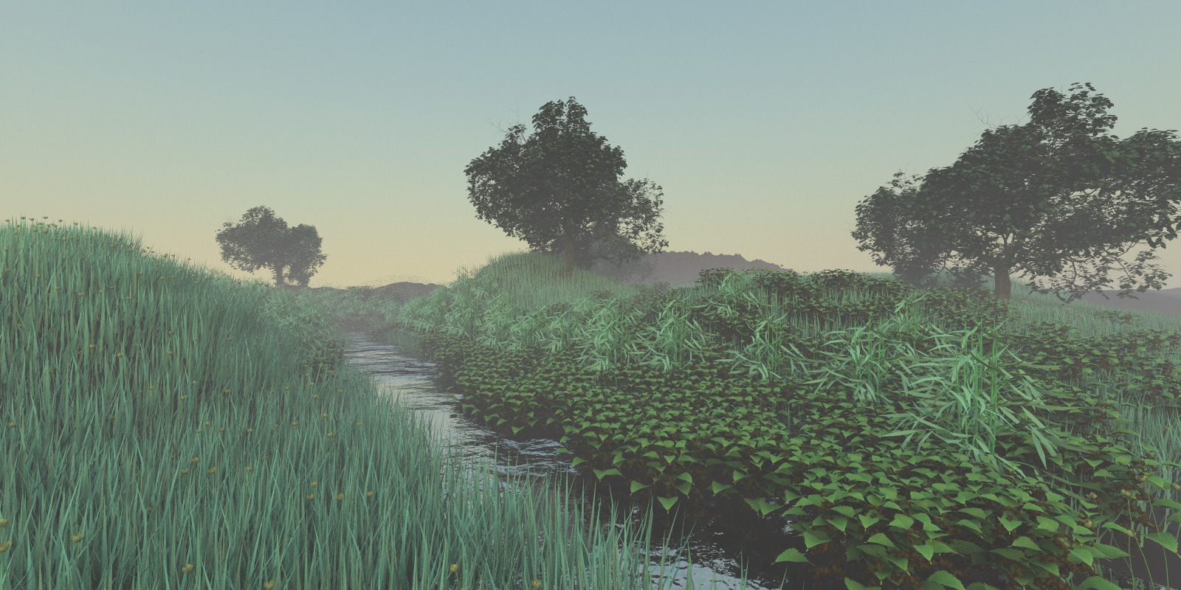
Some Ray-traced Images
Physically Based Ray Tracer

Slide 74
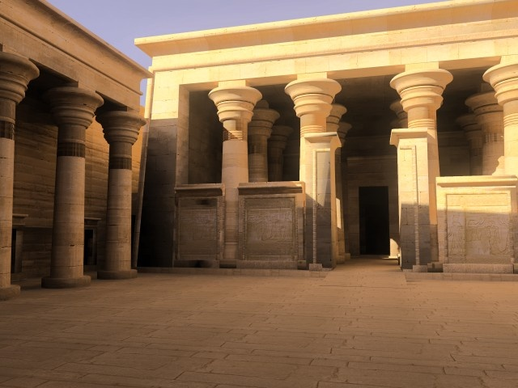
Some Ray-traced Images
Radiance Ray Tracer

Slide 75
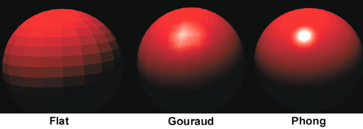

Shading Models

Slide 76

Shading Models

Slide 77



Shading Models
3 colors at triangle vertices known (e.g. via ray tracing)
Coordinates and therefore normal of the triangle known
Flat Gouraud Phong
All triangle points
have the same color, say v1.color
Linearly interpolate vertex colors
Linearly interpolate vertex normals, compute color with interpolated normal

Slide 78


Shading Models
3 colors at triangle vertices known (e.g. via ray tracing)
Coordinates and therefore normal of the triangle known
Phong model will pick up the highlight ☺
  Not possible with color averaging (Gouraud)
  Not possible with same color everywhere (Flat)

